Slide 1
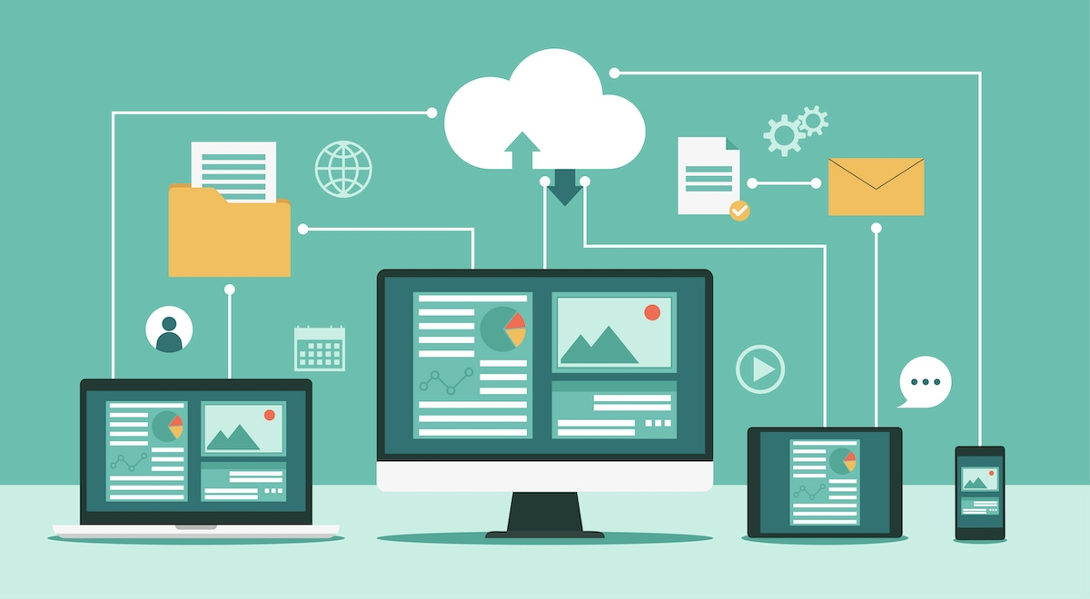
Why a network is important?
Networks are important for businesses because it means important files can be saved on one computers and accessed on another. Employees can share documents with each other virtually instead of printing them out and with the potential risk of losing them. By having a network to connect the business you are benefitting your company because if one computer breaks then you can use another and still have all your files. The two offices that separate your employees can also connect to a network which saves time when files need to be shared, especially if the offices aren’t close. It is one way to modernize your company so that there isn’t an ‘as and when’ basis.

Slide 2
Peer-to-peer network
Advantages:
Peer-to-peer networks have easy file sharing over long distances.
Peer-to-peer networks don’t need a network operating system or full-time system administrator, so the costs are reduced.
If the server crashes the devices, it is connected to aren’t affected.
It is easy to add extra devices into the network if more employees are hired.
There can be collaborations between devices with files that can be beneficial to other devices on the network.
Disadvantages:
Typically, peer-to-peer networks are less secure than other networks.
Each individual user has a responsibility to prevent viruses accessing the network.
There is no central server which leads to backup of data being difficult.

Slide 3
Client server networks
Advantages:
Client server networks are generally seen as more secure than peer-to-peer networks.
If one computer crashes the rest of the network is fine.
Security and backups are controlled centrally.
Users can easily share data.
All files are stored in a central location.
Larger networks than peer-to-peer networks.
Disadvantages:
Servers can be expensive.
Network managers need to employed.
You will need a specialist network operating system.
If the server fails, then there is a lot of disruption.

Slide 4
Conclusion
In conclusion I would say that if you want a network that will be worth your money you should invest in a peer-to-peer network. It is the cheaper option of the two networks and doesn’t need to spend money on a server and someone to maintain the network like you do with a client server network.
However, if you aren’t worried about the price and are more focused on easy access of documents then you should invest in a client server network. All files are in a centralized area in the server where they can be access by everyone.

